Slide 1
Programming Logic and Design Seventh Edition
Chapter 5
Looping

Slide 2
Objectives
In this chapter, you will learn about:
The advantages of looping
Using a loop control variable
Nested loops
Avoiding common loop mistakes
Using a for loop
Common loop applications

Slide 3
Understanding the Advantages of Looping
Looping makes computer programming efficient and worthwhile
Write one set of instructions to operate on multiple, separate sets of data
Loop: a structure that repeats actions while some condition continues

Slide 4
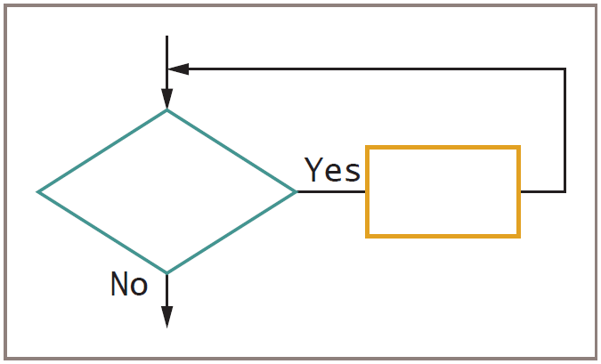
Understanding the Advantages of Looping (continued)
Figure 5-1 The loop structure

Slide 5
Using a Loop Control Variable
As long as a condition remains true, the statements in a while loop’s body execute
Control number of repetitions
Loop control variable initialized before entering loop
Loop control variable tested
Body of loop must alter value of loop control variable
Repetitions controlled by:
Counter
Sentinel value

Slide 6
Using a Definite Loop with a Counter
Definite loop
Executes a predetermined number of times
Counter-controlled loop
Program counts loop repetitions
Loop control variables altered by:
Incrementing
Decrementing

Slide 7
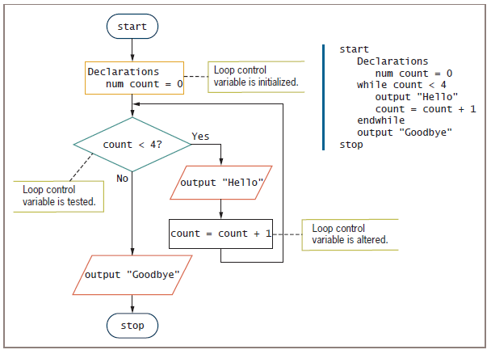
Figure 5-3 A counted while loop that outputs Hello four times

Slide 8
Using an Indefinite Loop with a Sentinel Value
Indefinite loop
Performed a different number of times each time the program executes
The user decides how many times the loop executes

Slide 9
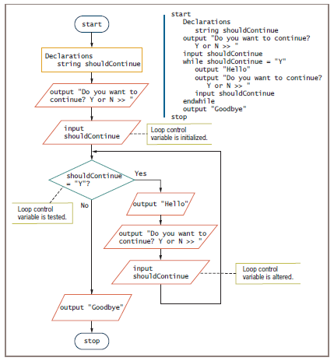
Figure 5-4 An indefinite while loop that displays Hello as long as the user wants to continue

Slide 10
Understanding the Loop in a Program’s Mainline Logic
Three steps should occur in every properly functioning loop
Provide a starting value for the variable that will control the loop
Test the loop control variable to determine whether the loop body executes
Alter the loop control variable

Slide 11
Nested Loops
Nested loops: loops within loops
Outer loop: the loop that contains the other loop
Inner loop: the loop that is contained
Needed when values of two (or more) variables repeat to produce every combination of values

Slide 12
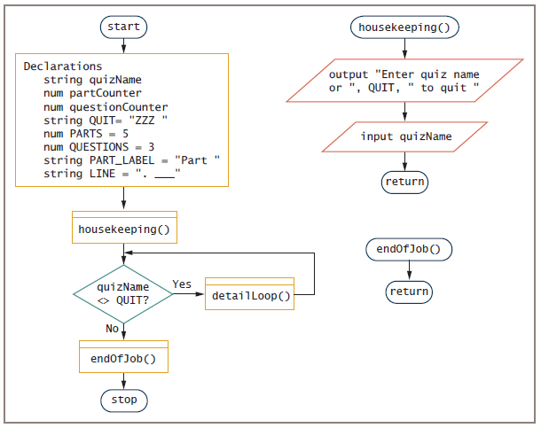
Nested Loops (continued)
Figure 5-8 Flowchart and pseudocode for AnswerSheet program

Slide 13
Avoiding Common Loop Mistakes
Mistake: neglecting to initialize the loop control variable
Example: get name statement removed
Value of name unknown or garbage
Program may end before any labels printed
100 labels printed with an invalid name

Slide 14
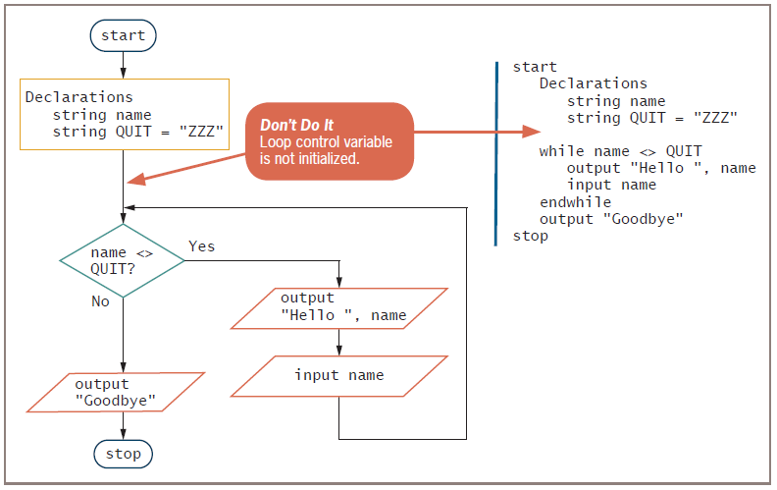
Figure 5-10 Incorrect logic for greeting program because the loop control variable initialization is missing

Slide 15
Avoiding Common Loop Mistakes (continued)
Mistake: neglecting to alter the loop control variable
Remove get name instruction from outer loop
User never enters a name after the first one
Inner loop executes infinitely
Always incorrect to create a loop that cannot terminate

Slide 16
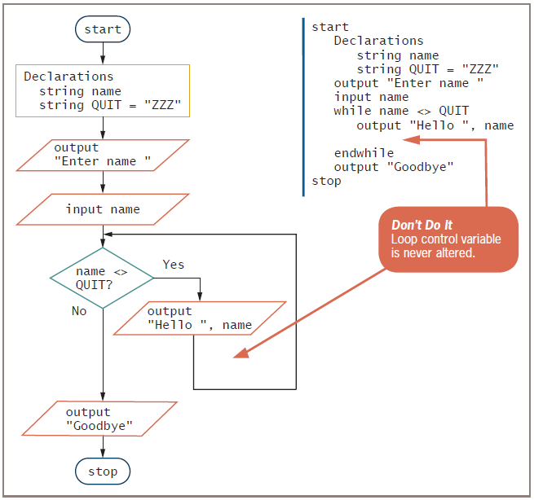
Figure 5-11 Incorrect logic for greeting program because the loop control variable is not altered

Slide 17
Avoiding Common Loop Mistakes (continued)
Mistake: using the wrong comparison with the loop control variable
Programmers must use correct comparison
Seriousness depends on actions performed within a loop
Overcharge insurance customer by one month
Overbook a flight on airline application
Dispense extra medication to patients in pharmacy

Slide 18
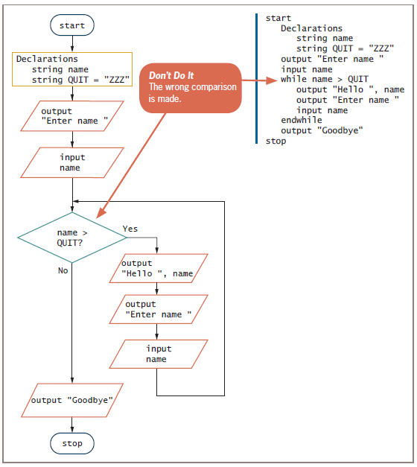
Figure 5-12 Incorrect logic for greeting program because the wrong test is made with the loop control variable

Slide 19
Avoiding Common Loop Mistakes (continued)
Mistake: including statements inside the loop that belong outside the loop
Example: discount every item by 30 percent
Inefficient because the same value is calculated 100 separate times for each price that is entered
Move outside the loop for efficiency

Slide 20
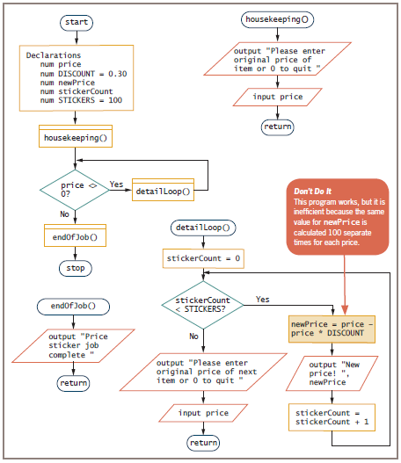
Figure 5-13 Inefficient way to produce 100 discount price stickers for differently priced items

Slide 21
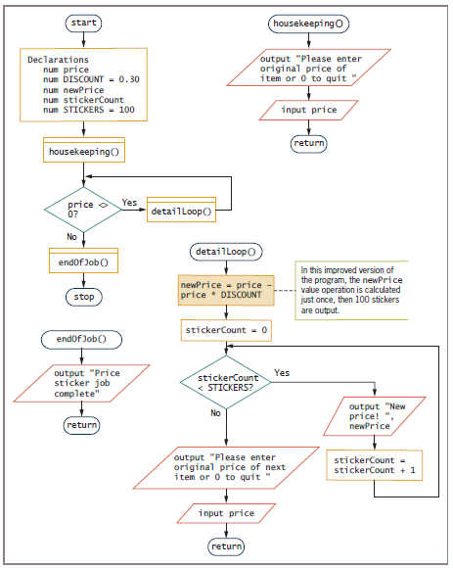
Figure 5-14 Improved discount sticker-making program

Slide 22
Using a for Loop
for statement or for loop is a definite loop
Provides three actions in one structure
Initializes
Evaluates
Alters
Takes the form:
for loopControlVariable = initialValue to finalValue step stepValue
do something
endfor

Slide 23
Using a for Loop (continued)
Example
for count = 0 to 3 step 1
output "Hello"
endfor
Initializes count variable to 0
Checks count variable against the limit value 3
If evaluation is true, for statement body prints the word “Hello”
Increases count by 1

Slide 24
Using a for Loop (continued)
while statement could be used in place of for statement
Step value: the amount by which a loop control variable changes
Can be positive or negative (incrementing or decrementing the loop control variable)
Default step value is 1
Programmer specifies a step value when each pass through the loop changes the loop control variable by a value other than 1

Slide 25
Using a for Loop (continued)
Pretest loop: the loop control variable is tested before each iteration
for loops and while loops are pretest loops
Posttest loop: the loop control variable is tested after each iteration
do…while is a posttest loop

Slide 26
Common Loop Applications
1-Using a loop to accumulate totals
Examples
Business reports often include totals
List of real estate sold and total value
Accumulator: variable that gathers values
Similar to a counter
Counter increments by 1
Accumulator increments by some value

Slide 27
Common Loop Applications (continued)
Accumulators require three actions
Initialize the accumulator to 0
Accumulators are altered: once for every data set processed
At the end of processing, accumulators are output
Summary reports
Contain only totals with no detail data
Loops are processed but detail information is not printed

Slide 28
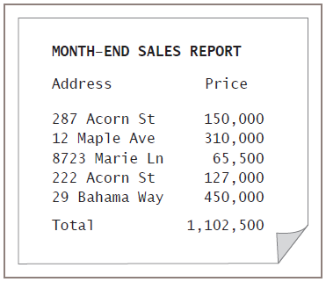
Common Loop Applications (continued)
Figure 5-16 Month-end real estate sales report

Slide 29
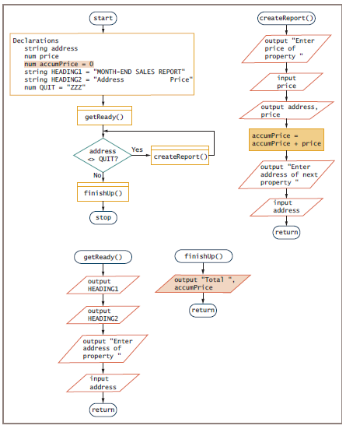
Figure 5-17 Flowchart and pseudocode for real estate sales report program

Slide 30
Common Loop Applications (continued)
2-Using a loop to validate data
Defensive programming: preparing for all possible errors before they occur
When prompting a user for data, no guarantee that data is valid
Validate data: make sure data falls in acceptable ranges (month values between 1 and 12)
GIGO: Garbage in, garbage out
Unvalidated input will result in erroneous output

Slide 31
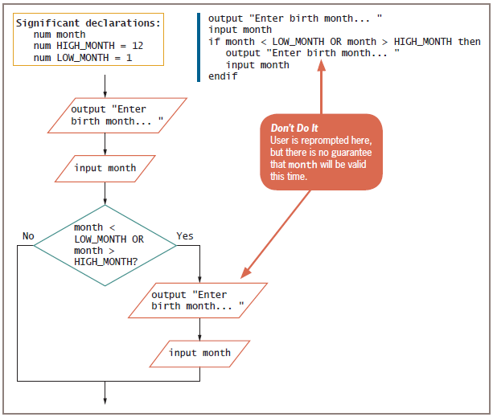
Figure 5-18 Reprompting a user once after an invalid month is entered

Slide 32
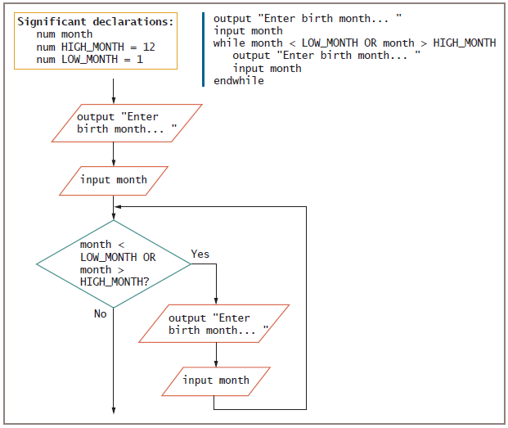
Figure 5-19 Reprompting a user continuously after an invalid month is entered

Slide 33
Common Loop Applications (continued)
3-Limiting a reprompting loop
Reprompting can be frustrating to a user if it continues indefinitely
Maintain a count of the number of reprompts
Forcing a data item means:
Override incorrect data by setting the variable to a specific value

Slide 34
Common Loop Applications (continued)
4-Validating a data type
Validating data requires a variety of methods
isNumeric() or similar method
Provided with the language translator you use to write your programs
isChar() or isWhitespace()
Accept user data as strings
Use built-in methods to convert to correct data types

Slide 35
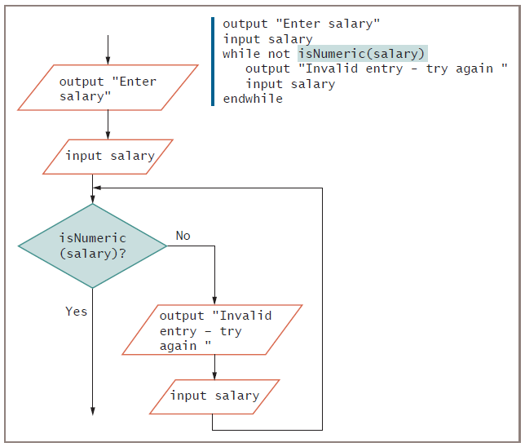
Common Loop Applications (continued)
Figure 5-21 Checking data for correct type

Slide 36
Common Loop Applications (continued)
5-Validating reasonableness and consistency of data
Many data items can be checked for reasonableness
Good defensive programs try to foresee all possible inconsistencies and errors

Slide 37
Summary
Loops write one set of instructions that operate on multiple, separate sets of data
Three steps must occur in every loop
Initialize the loop control variable
Compare the variable to some value
Alter the variable that controls the loop
Nested loops: loops within loops
Nested loops maintain two individual loop control variables
Alter each at the appropriate time

Slide 38
Summary (continued)
Common mistakes made by programmers
Neglecting to initialize the loop control variable
Neglecting to alter the loop control variable
Using the wrong comparison with the loop control variable
Including statements inside the loop that belong outside the loop
Most computer languages support a for statement
for loop used when the number of iterations is known
Loops are used to accumulate totals in business reports and to reprompt users for valid data

Slide 39
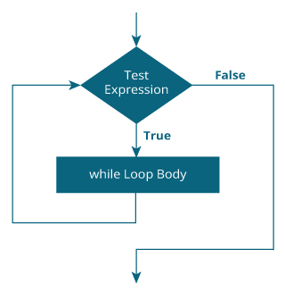
while loop in “C”
// Print numbers from 1 to 5
#include <stdio.h>
int main()
{
int i = 1;
while (i <= 5)
{
printf("%d\n", i);
++i;
}
return 0;
}
Output
1
2
3
4
5

